Slide 1

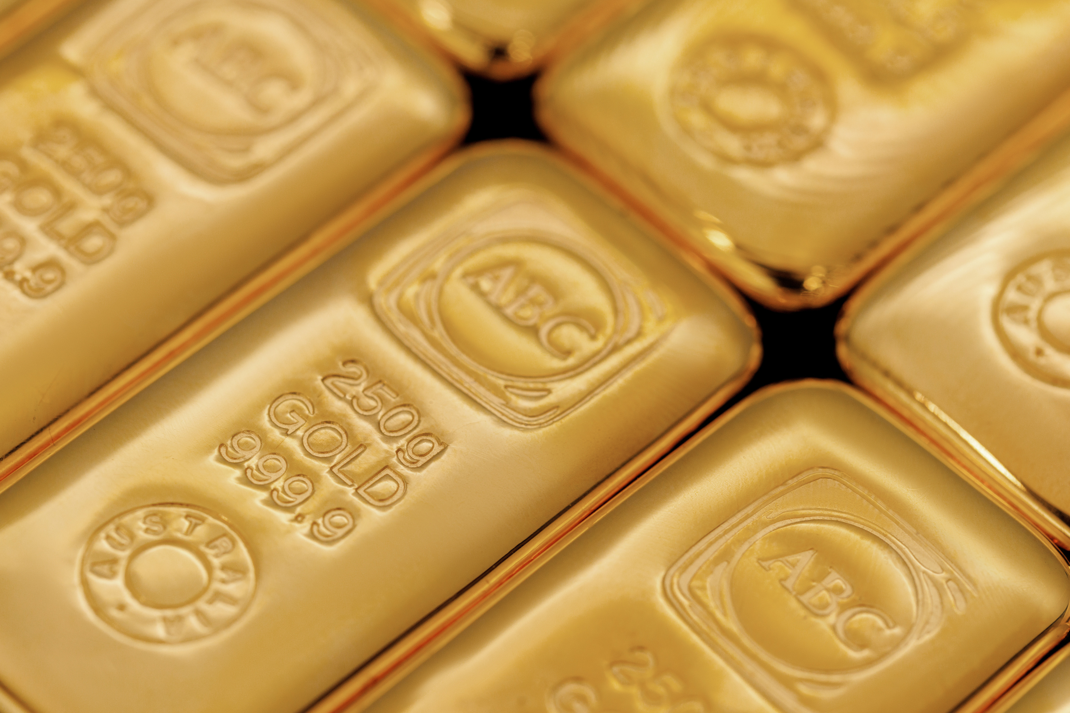

ABC REFINERY
PRECIOUS METALS TECHNICAL ANALYSIS REPORT
Q1 2026

Slide 2
GOLD: IN BRIEF
Welcome to the end-of-Q1 report, looking at gold and AUD through a more or less technical lens. As always, The Pod of Gold podcast with Shae Russell is a great resource for discussion on gold and broader macro themes.
As expected, it’s all about the Middle East.
Firstly, everything is about crude and natural gas - or what flows downstream from them. In our world, there is a huge variety of products impacted: feedstock for ethylene crackers in Southeast Asia, aluminum produced using hitherto cheap energy, and helium sourced from natural gas wells, which we now know is critical for chip production.
And of course, 20% of the world’s phosphate supply for fertiliser and 45% of the world’s urea is on the wrong side of the Straits - something that will restrict supply to much of the world through 2026, with as-yet unknown consequences for poorer nations.
Secondly, everything else is about when Donald Trump decides to declare “victory” over Iran. Of course, we don’t really know what victory looks like, as there hasn’t been a clear articulation of America’s war aims, at least not publicly—as they have shifted since the war began. Victory may be declared several times, in several different ways.
At the macro level, this is a “terms of trade shock,” particularly impacting major energy importers in Europe and East Asia—think Korea, India, China, and Japan.
So far, that trade shock hasn’t filtered through significantly, which suggests that markets collectively believe either that the conflict won’t last that long, or that geopolitical shocks should be faded. Given past experience, that second point makes sense—risk assets have often continued their rally after the initial shock has been absorbed. Is this time different?
For gold bulls, this has been a disappointing period, as the USD has rallied by about 2% since the start of the conflict (I think the USD was already entering a positive phase just prior to the onset of the attack on Iran, and the attack amplified that), while gold in USD has declined by over 10%.
As long as the conflict continues and the Straits of Hormuz remain de facto closed, I think the dollar remains a beneficiary—a safe haven. While physical gold demand should remain strong, the gold price itself may stay relatively defensive, behaving more like a risk asset. If a clear declaration of victory is made by America, that may raise some questions for gold.
Expect a rebound to USD 4,800–4,850 (written during the morning of 20 March, Sydney time, for reference).

Slide 3
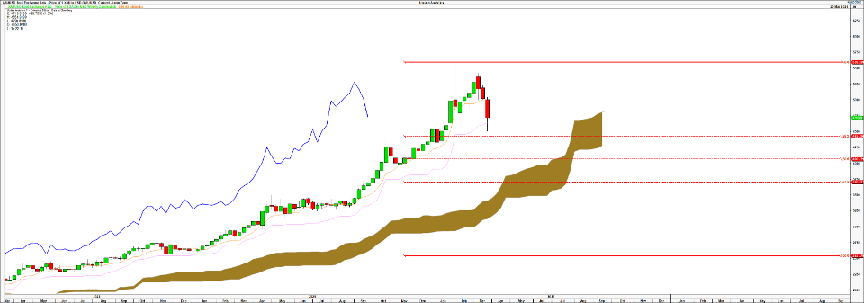
WEEKLY ICHIMOKU CLOUD CHART
The recent drop in the gold price has found some support at the Weekly Standard line, after dropping through briefly, in the vicinity of the 38.20 % retracement of the Nov 2024-Jan 2026 upswing.
Sources: ABC Refinery, Bloomberg, Updata Charts

Slide 4
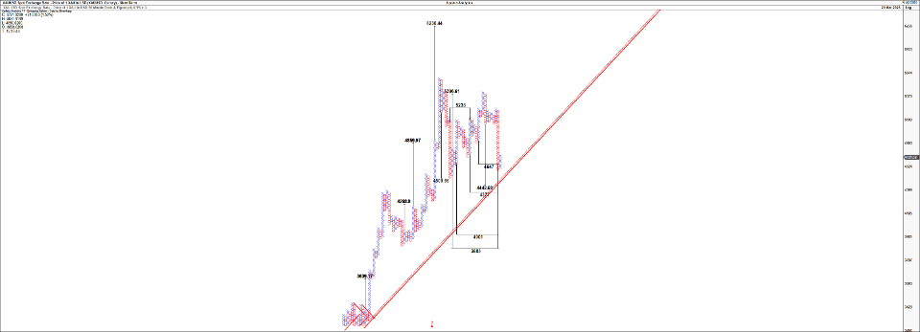
GOLD HOURLY POINT AND FIGURE - MEDIUM TERM
Despite the bullish trend, targets suggest that significant scope remains for a drawdown in gold after the sideways chop post the January highs. The USD6236 target is invalidated if gold closes on an hourly basis below USD4290 on this chart, which implies a close below USD4260 or so.
Sources: ABC Refinery, Bloomberg, Updata Charts

Slide 5
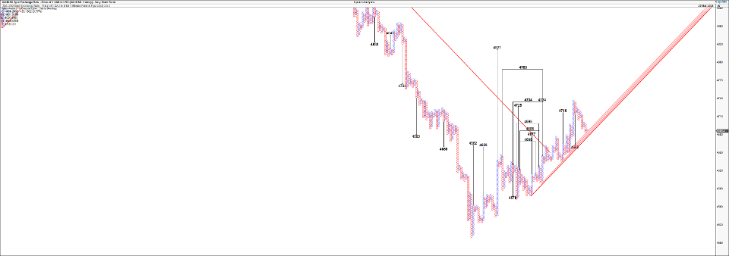
GOLD POINT AND FIGURE – SHORTER TERM
Gold has targets back to the Daily Cloud base which is now likely to be a resistance level.
Sources: ABC Refinery, Bloomberg, Updata Charts

Slide 6
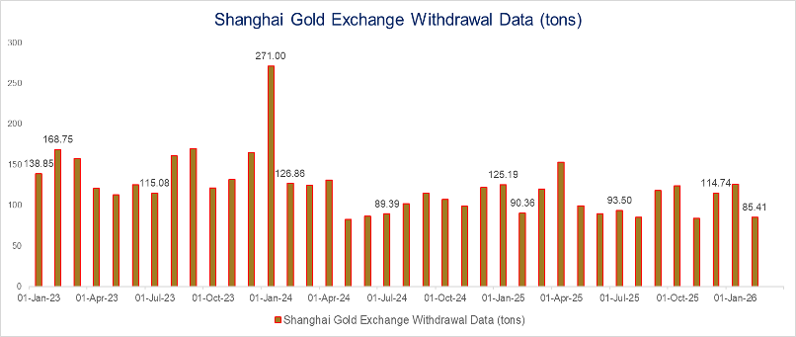
SHANGHAI GOLD EXCHANGE DEMAND
Demand on the SGE up until February. A decline in overall demand relative to last year, and significantly lower than 2023 and 2024 equivalents.
Sources: ABC Refinery, Bloomberg

Slide 7
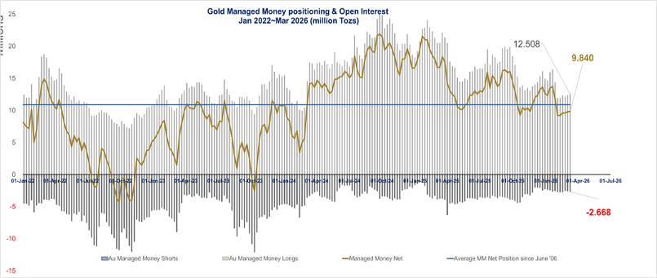
GOLD POSITIONING – MANAGED MONEY ON THE CME
Managed Money sector position below the long term average, likely a consequence of recent volatility and post Jan declines. Shorts remain sidelined..

Slide 8
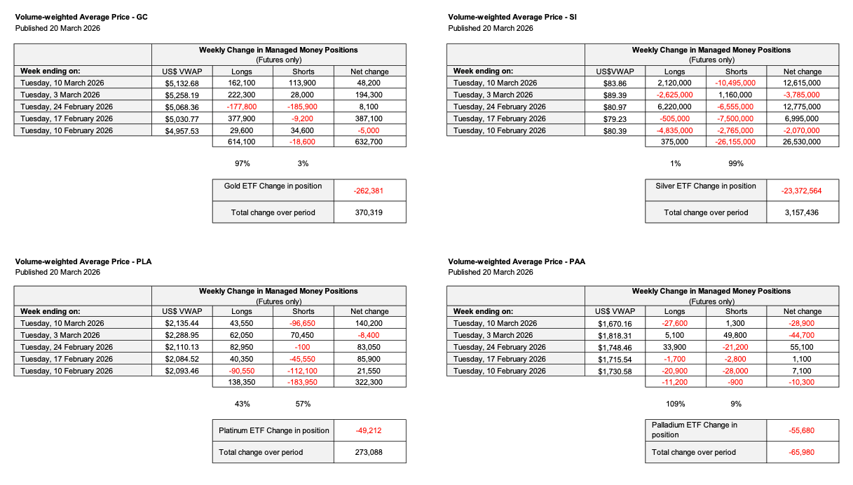
PRECIOUS METALS POSITIONING AND
VOLUME-WEIGHTED AVERAGE PRICING (TABLES)
Gold: Managed Money longs grew over the last 5 weeks, but length added in the last two weeks look underwater.
ETFs have seen significant outflows.

Slide 9
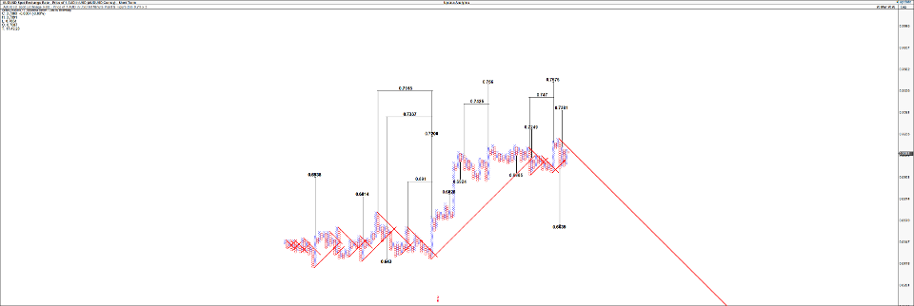
THE AUD – VIA HOURLY POINT AND FIGURE
The AUD has multiple targets to 0.74 and 0.75, probably aided by expected tightening from the RBA, but upside targets are threatened if the war in the Gulf stretches out for longer.
Sources: ABC Refinery, Bloomberg, Updata Charts

Slide 10
DISCLAIMER
This article has been prepared by ABC Refinery (Australia) Pty Limited (ABN 86 621 121 079). The information contained in this article or internet related link (collectively, Document) is of a general nature and is provided for information purposes only. It is not intended to constitute advice, nor to influence any person in making a decision in relation to any precious metal or related product. To the extent that any advice is provided in this Document, it is general advice only and has been prepared without taking into account your objectives, financial situation or needs (your Personal Circumstances). Before acting on any such general advice, we recommend that you obtain professional advice and consider the appropriateness of the advice having regard to your Personal Circumstances. If the advice relates to the acquisition, or possible acquisition of any precious metal or related product, you should obtain independent professional advice before making any decision about whether to acquire it.
Although the information and opinions contained in this document are based on sources we believe to be reliable, to the extent permitted by law, ABC and its associated entities do not warrant, represent or guarantee, expressly or impliedly, that the information contained in this document is accurate, complete, reliable or current. The information is subject to change without notice and we are under no obligation to update it. Past performance is not a reliable indicator of future performance. If you intend to rely on the information, you should independently verify and assess the accuracy and completeness and obtain professional advice regarding its suitability for your Personal Circumstances.
To the extent possible, ABC, its associated entities, and any of its or their officers, employees and agents accepts no liability for any loss or damage relating to any use or reliance on the information in this document.
This document may not be distributed or reproduced without consent. © Australian Bullion Company (NSW) Pty Limited 2020.

